Slide 1

DATABASE MANAGEMENT SYSTEM PROJECT
Team-4A17

Slide 2

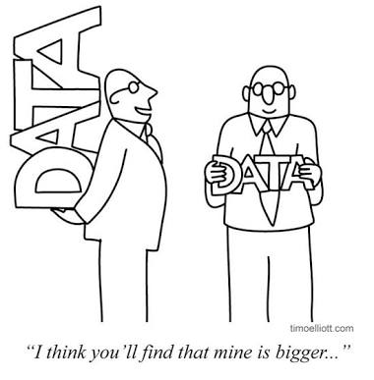
APPLIANCE STORE Management System
Team-4A17
Team members
Anusha Raikar
Apoorva Jinde
Archana Badagi
Ashwini Banagar
USN
-01FE18BCS043
-01FE18BCS044
-01FE18BCS045
-01FE18BCS054

Slide 3


Role of team members
Anusha Raikar:
Collection of all data from the clients required for the project. Insertion of values GUI validations done.
Apoorva Jinde:
GUI implementation , Exceptions handling, plotting graphs.
Archana Badagi:
Interaction with the client. GUI frames,connections based on URL pathing
Ashwini Banagar:
GUI frames, connections and documentation done, final ppt prepared and designing of the web pages.

Slide 4
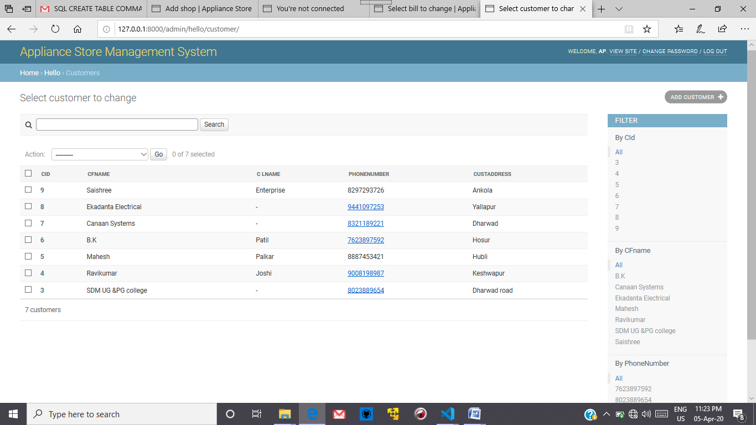
Figure 1.Customer Table

Slide 5
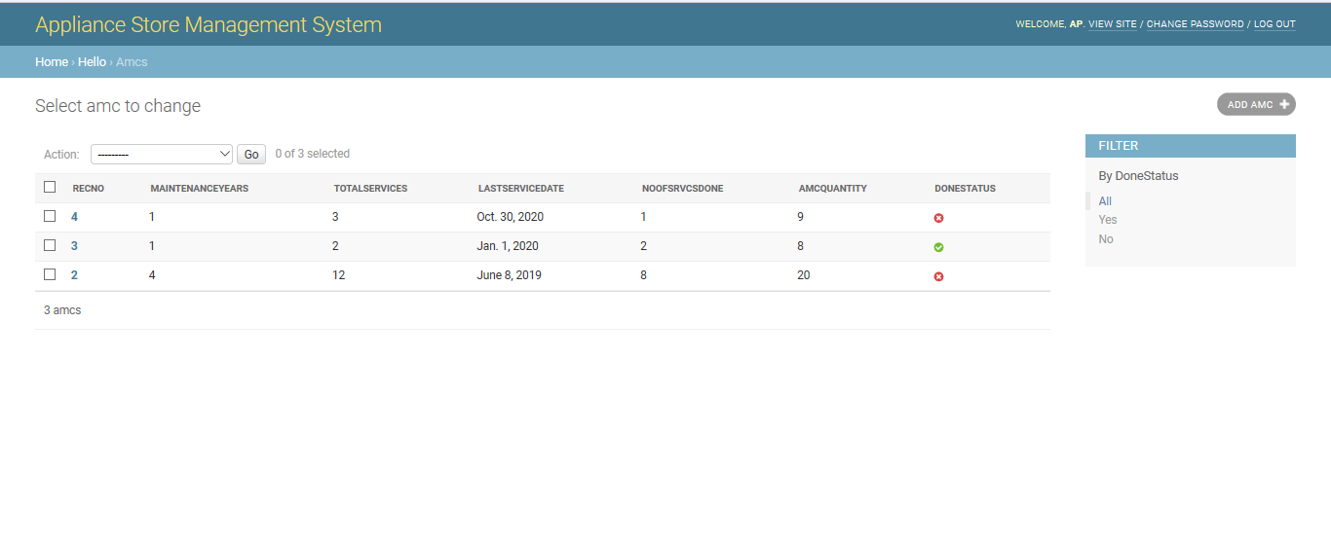
Figure 2 AMC table

Slide 6
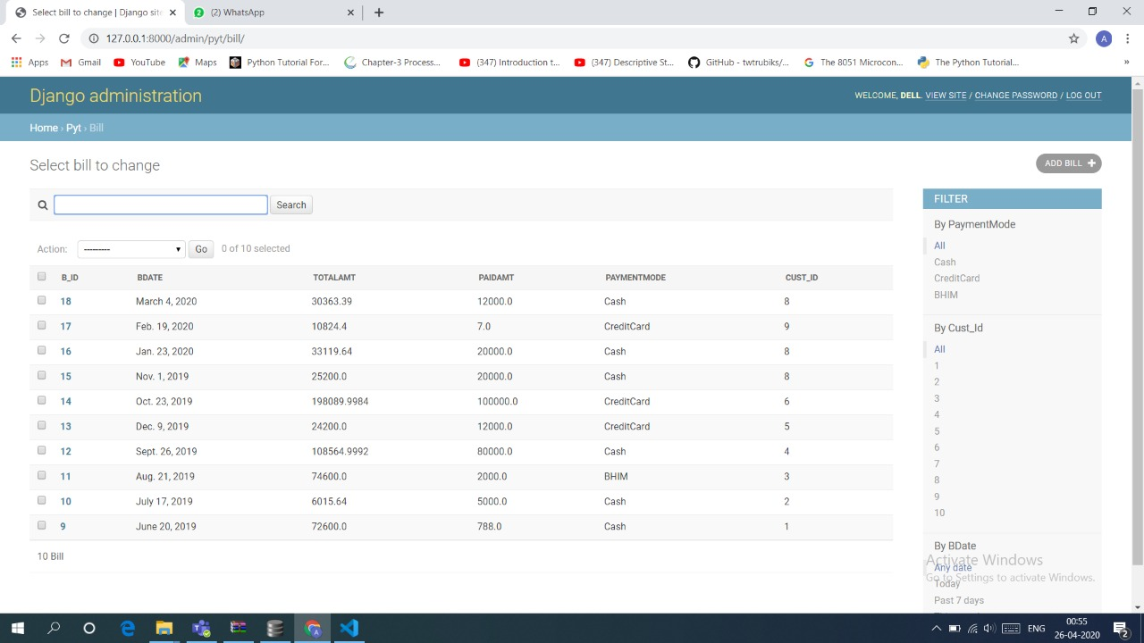
Figure 3 Bill Table

Slide 7
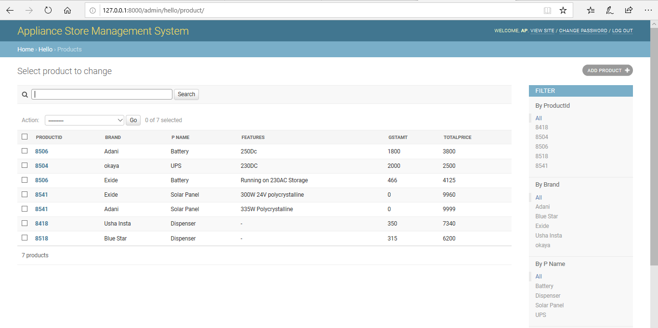
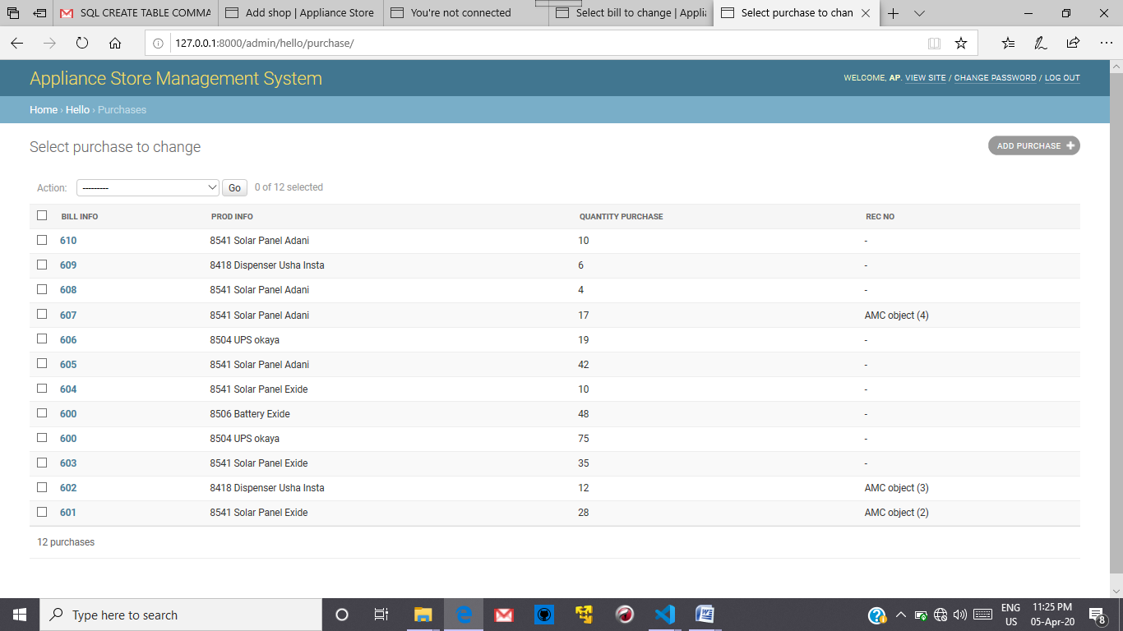
Figure 5 Products Table
Figure 6 Purchases Table

Slide 8
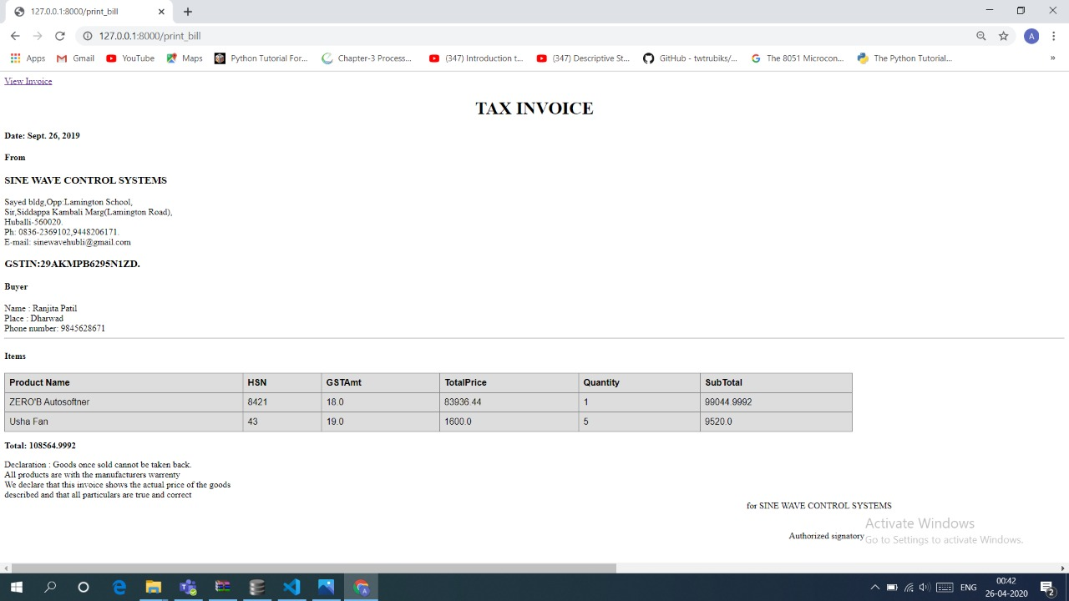
GUI Interface for bills and graphs
This is the bill with automated calculation we get after entering the bill number

Slide 9
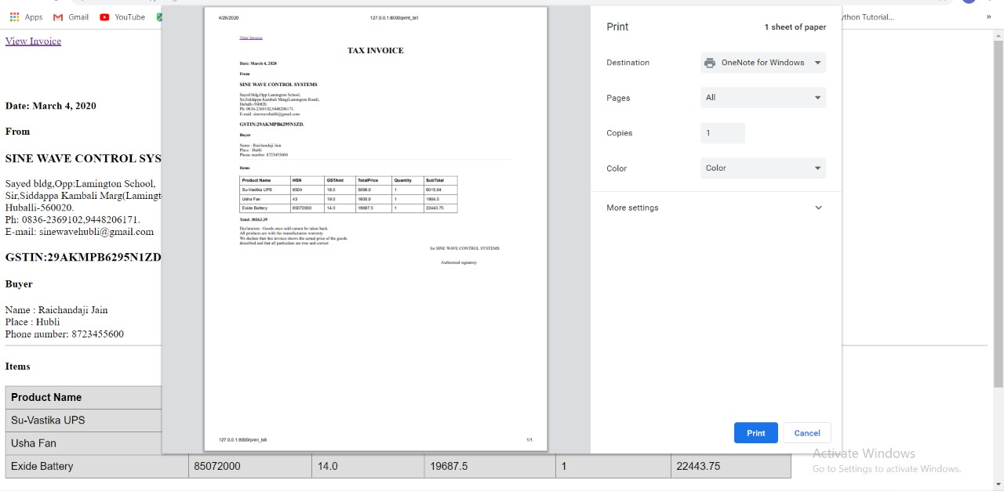
To convert to the pdf we need to click the button view invoice at the corner so that the pdf of the bill is generated

Slide 10
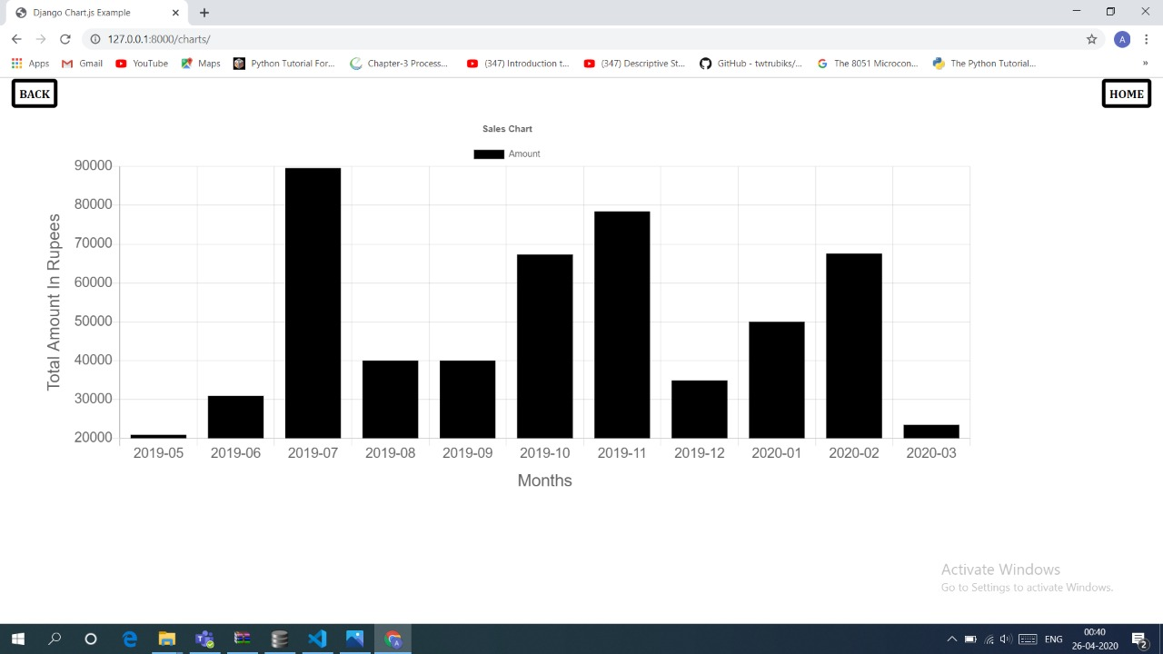
Few Snapshots of our annual report
This is the annual Sales Report for the previous year

Slide 11
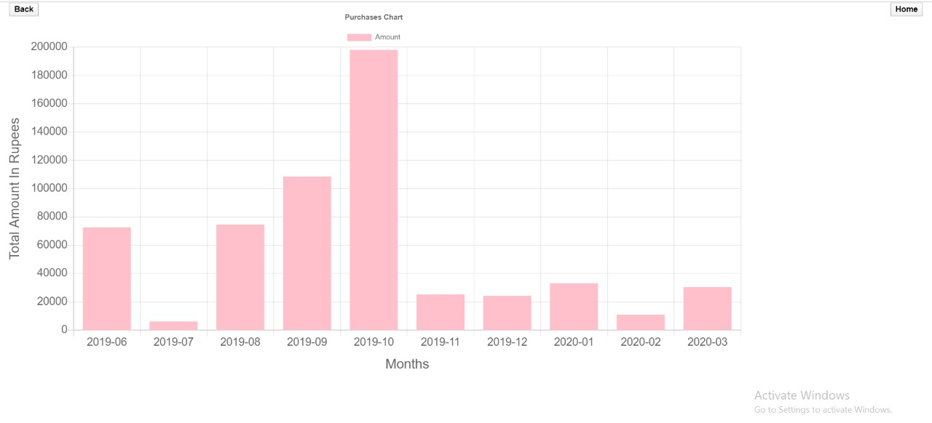
Purchase Analysis of the goods by the customers in the previous year

Slide 12
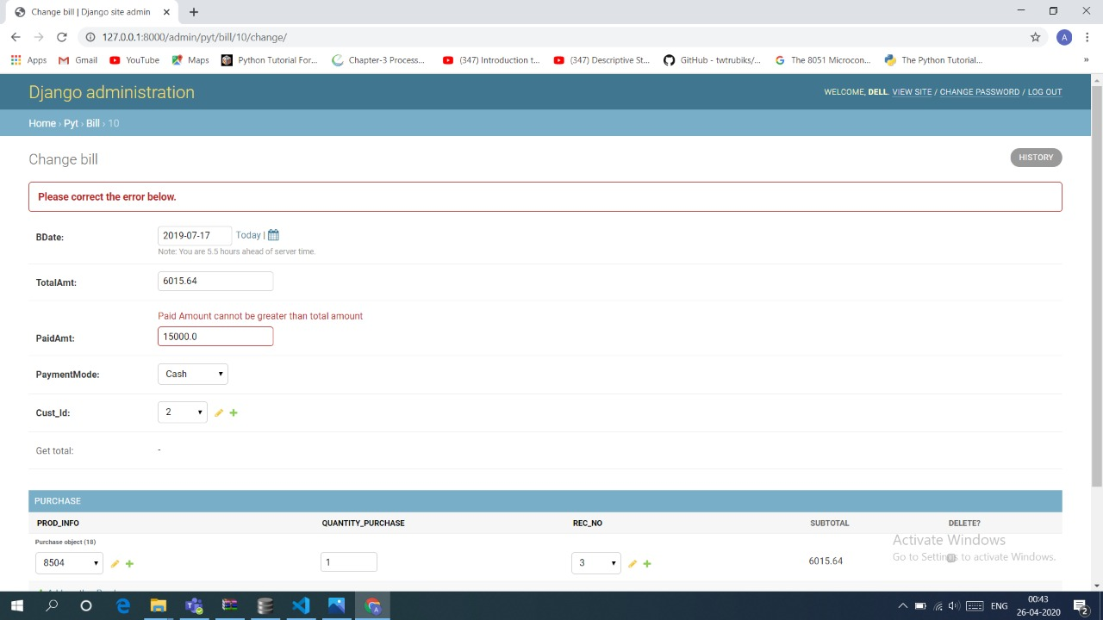
EXCEPTION HANDLING
Conditional validations like total amount cannot be less than paid amount , quantity purchased cannot be less than amc quantity are handled.

Slide 13
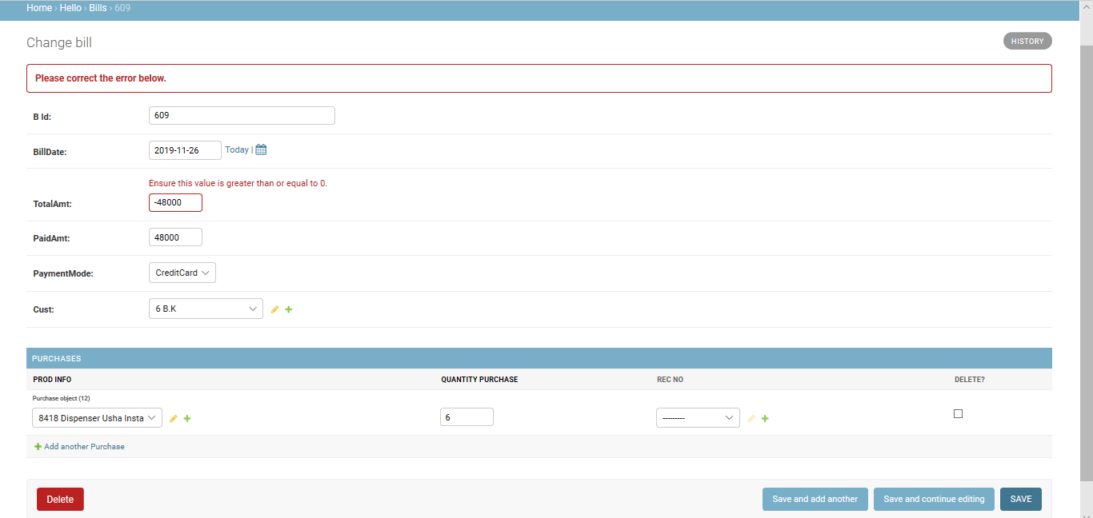

Slide 14
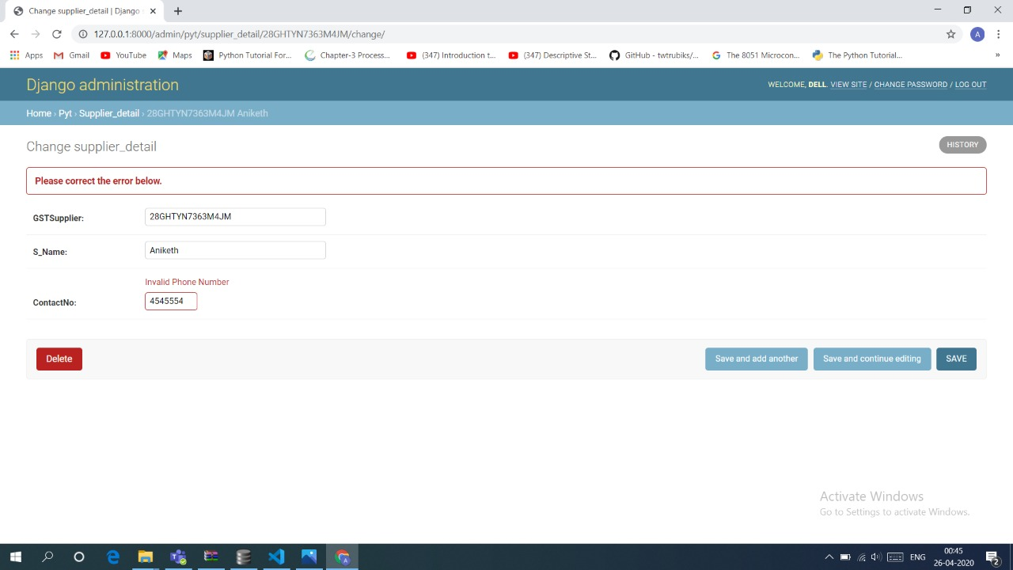

Slide 15

THANK YOU

